Slide 1
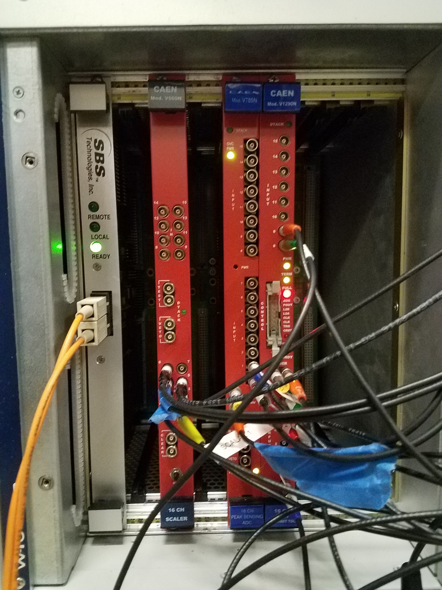
Slot number is not critical.
Traditionally, Slot 2: ADC,
Slot 3:Scaler, Slot 4:TDC
PCI to VME fiber bridge
CAEN V560N 16 channel scaler
CAEN V785N 16 channel ADC
CAEN V1290 16 channel TDC

Slide 2
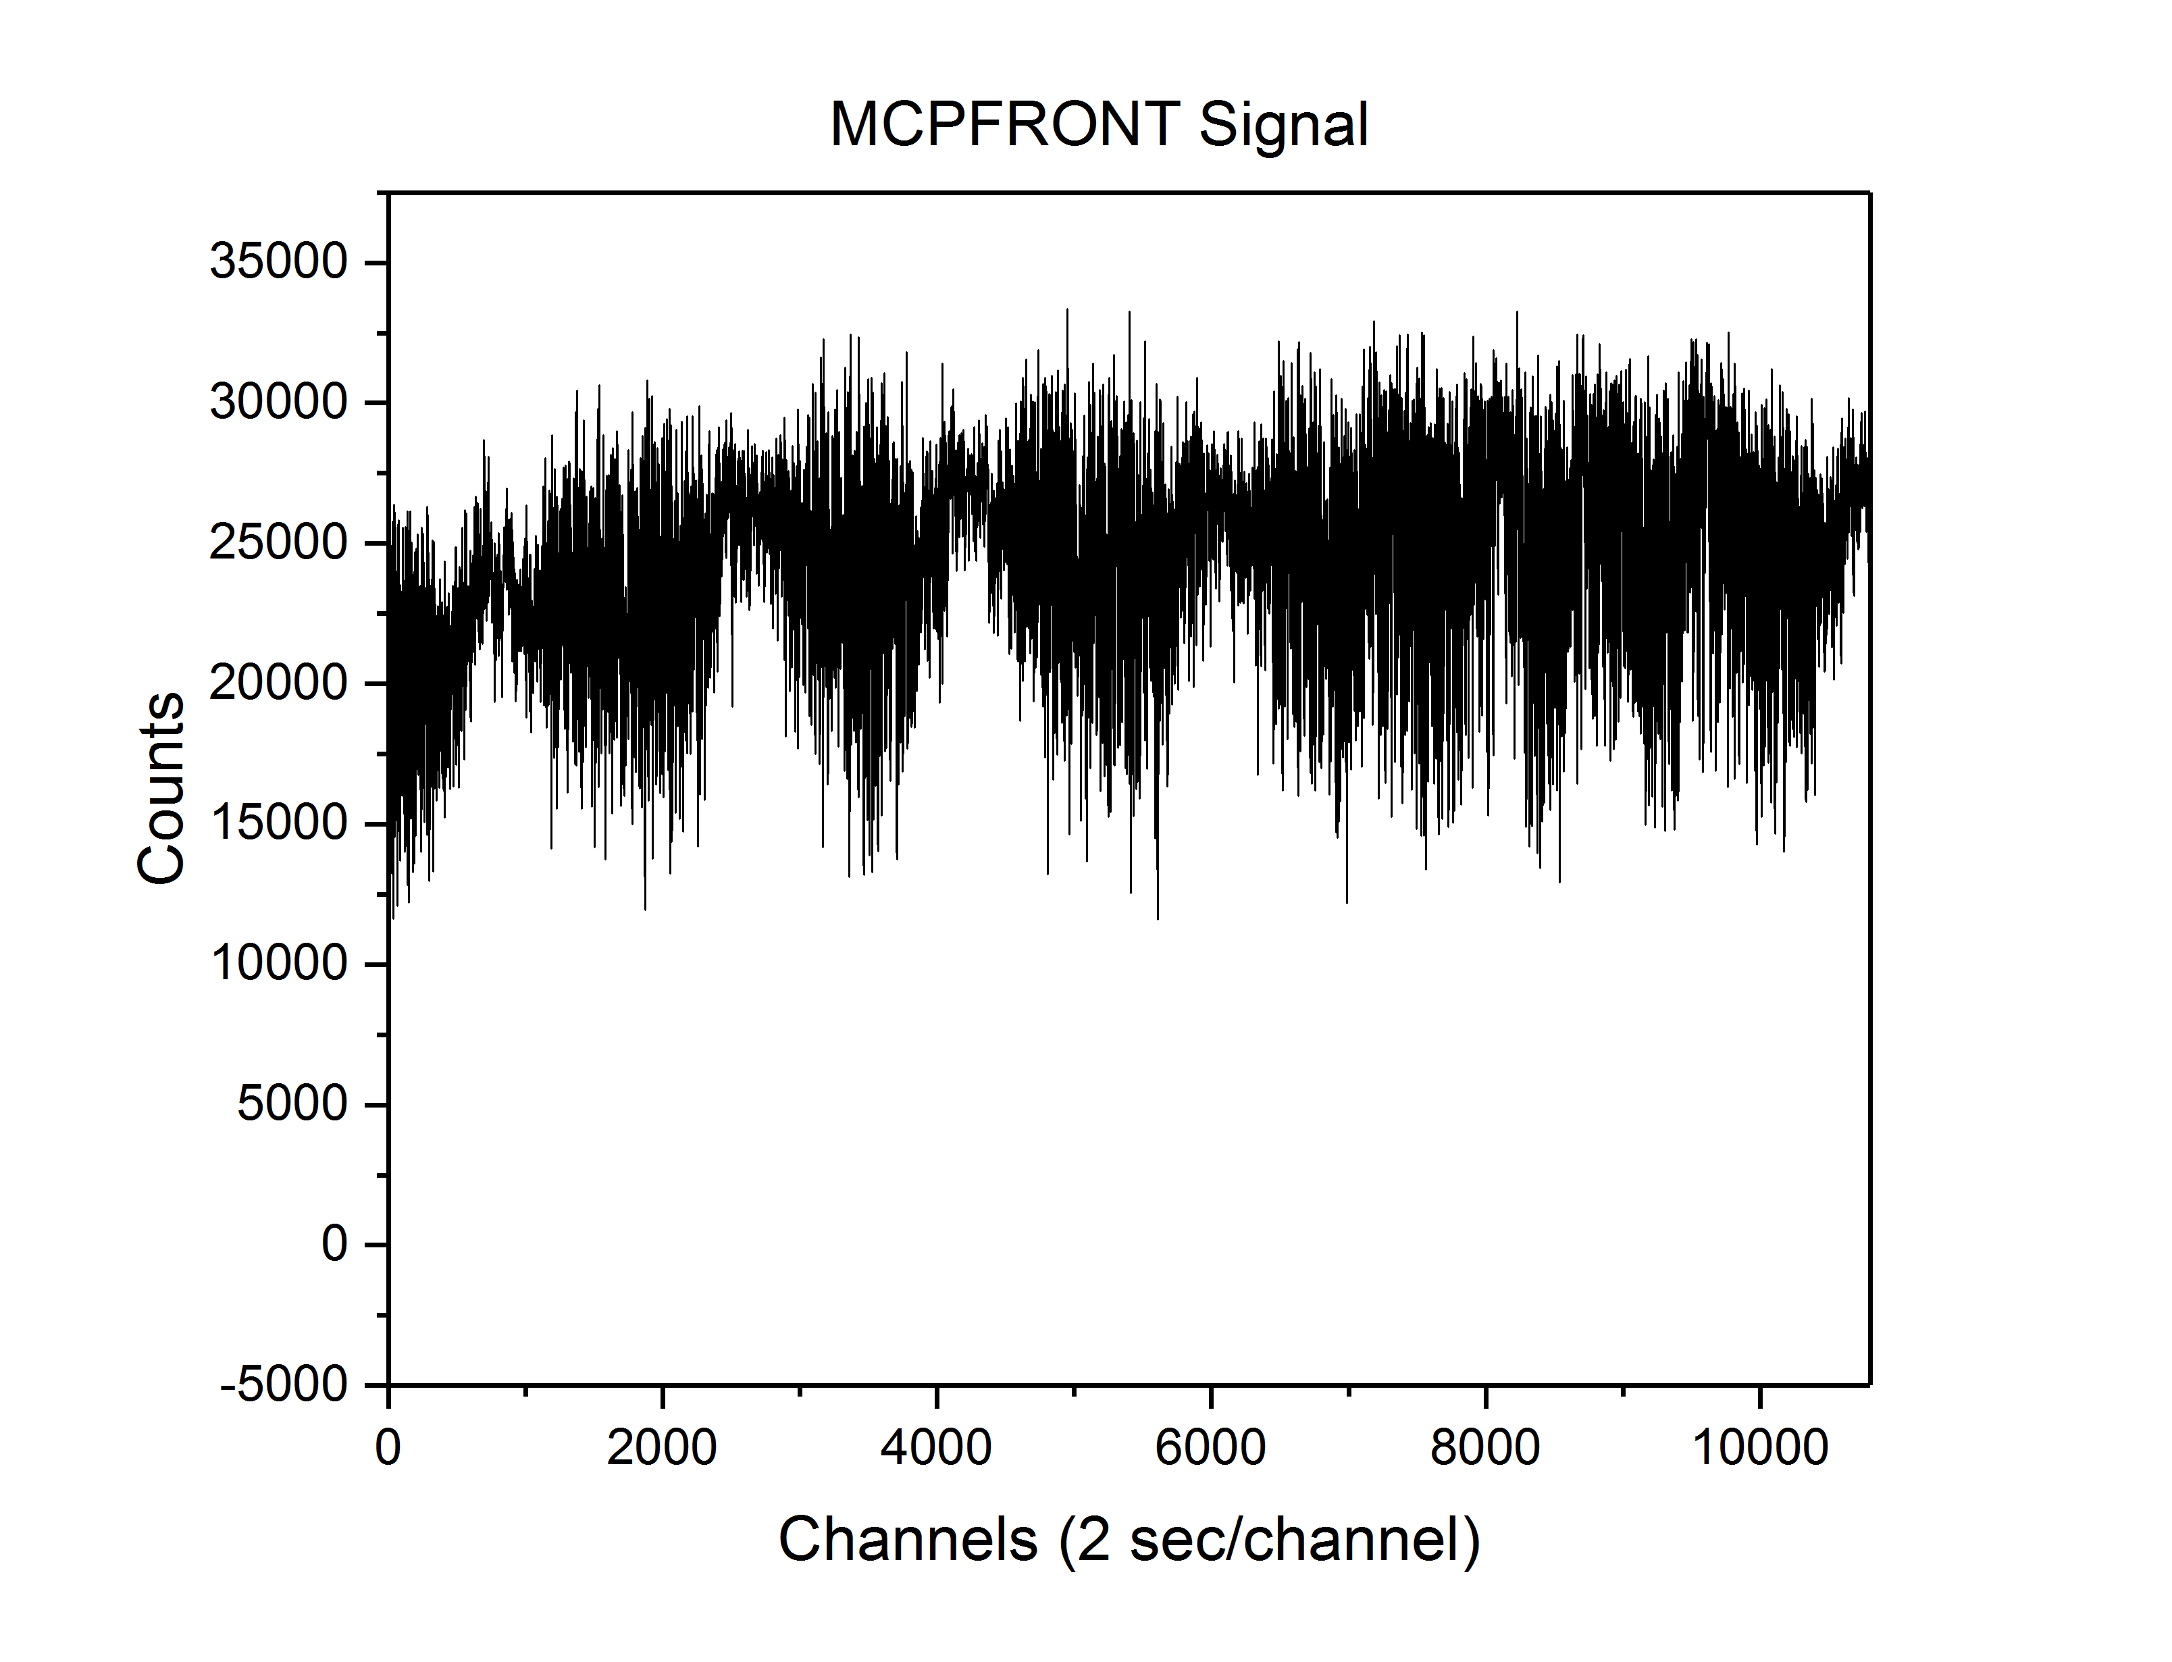
CAEN
Mod. V560N
CAEN V560N 16 Channel 32-bit Scaler
Negative NIM inputs (-800 mV)
32 bit word for each input, maximum of 4,294,967,295 counts
All scaler channels are read and cleared every n seconds, usually n=2
Scalers can be used, sometimes with voltage-to-frequency converters, to produce “strip charts”
14
15
12
13
10
11
8
9
TEST
DTACK
VETO
6
7
4
5
2
3
0
1
CLEAR
MAN
CLR
16 CH
SCALER

Slide 3
CAEN V785N 16 Channel ADC
Gate Common signal negative NIM (-800 mV)
16 inputs, 0-4 V unipolar signals
1 kΩ input impedance, > 50 nsec rise time
4096 channels for the full 4 V range, 2.8 μsec conversion time

Slide 4
CAEN V1290N Multi-hit 16 Channel TDC
Negative NIM signals (-800 mV)
1 channel = 24.414 psec
Time is difference between all other inputs and input 0
Up to 16 hits/input
Search window width settable in software, common stop

