Slide 1
SpecTcl
Online/Offline Analysis Code Tutorial
Kevin Carnes
3/26/2018

Slide 2
Online DAQ Linux computers:
Fizeau – Itzik’s group, ECR area
Geissler – Artem’s group, PULSAR
Avogadro – Daniel’s group, PULSAR
Ampere – Raju, Sq. Room
Henry – New machine under development
Newer version of Linux Ubuntu
Offline analysis Linux computers:
All rack mount machines without
consoles, housed in CW31
Auger
Balmer
Fourier
Oppy
Stark
Stern

Slide 3
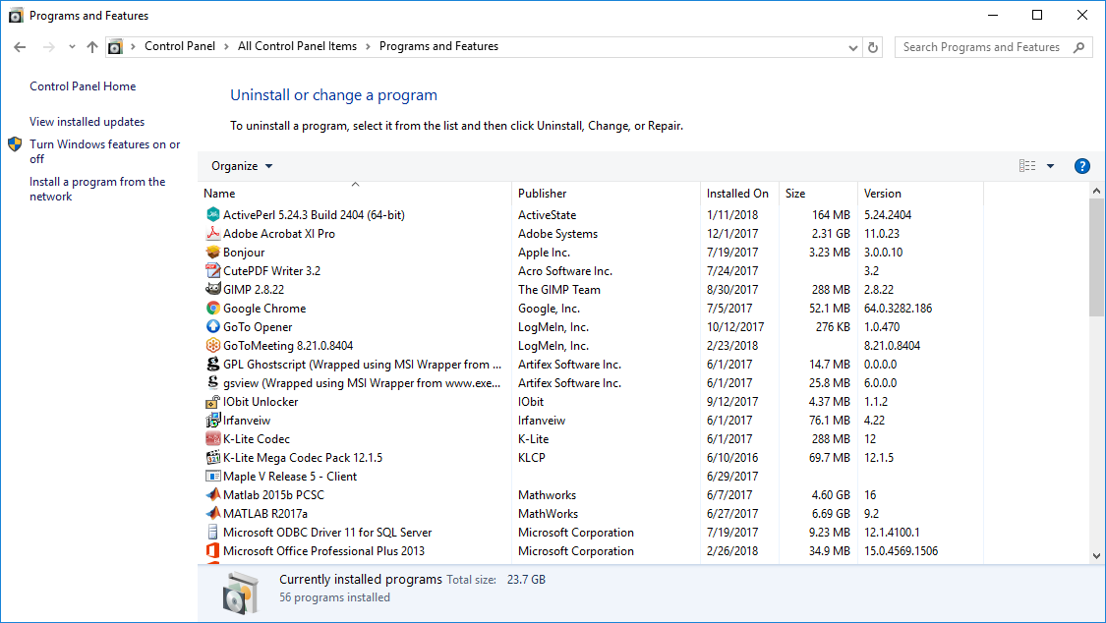
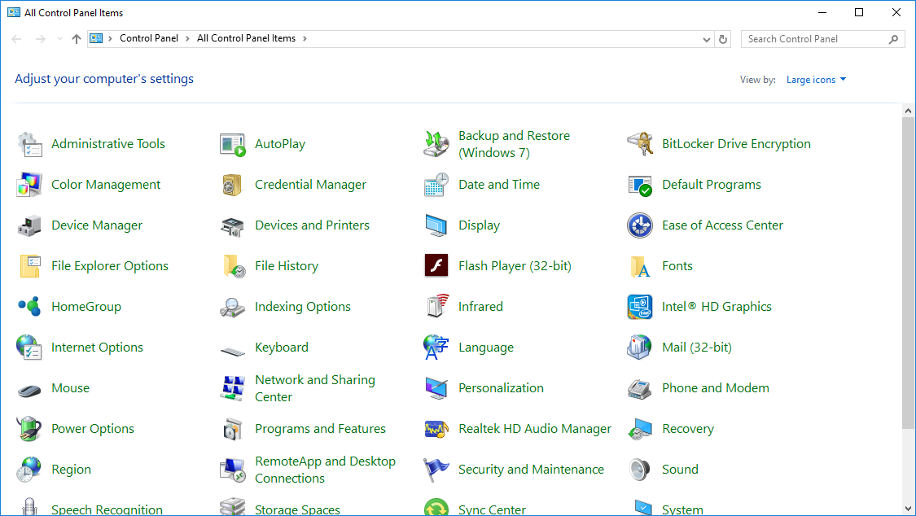
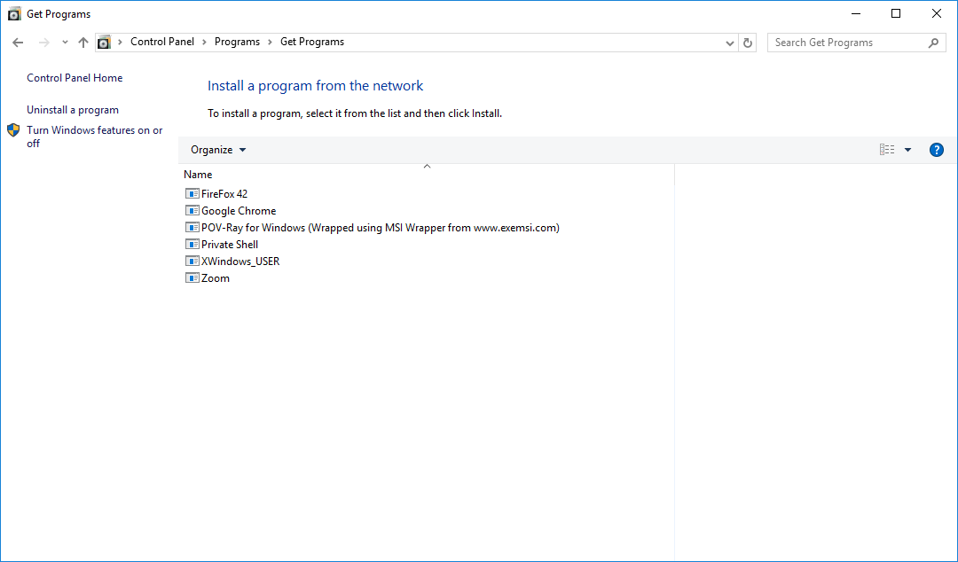
Use Private Shell and Xming to
connect to Linux PC from Windows
These can be installed on Windows 7
using “Run Advertised Programs”
For Windows 10, search for Control Panel

Slide 5
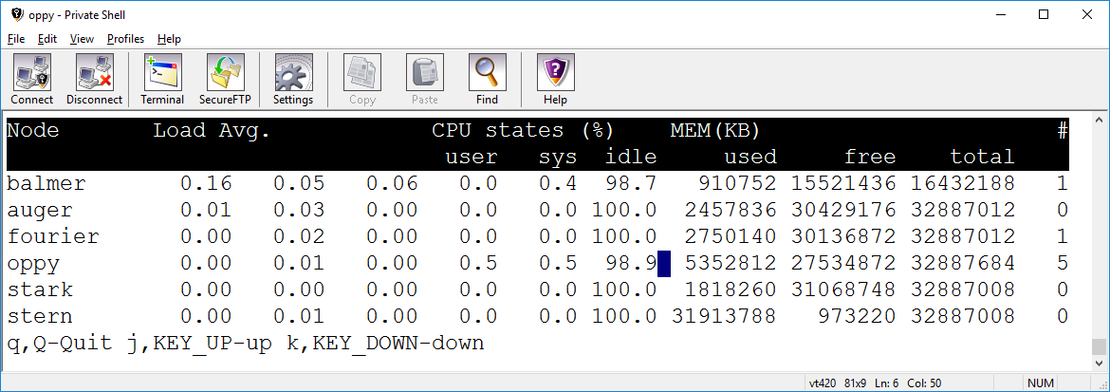
nctop – Linux command to check load and number of users on networked machines
Use this to decide which machine to do analysis on. Only works with offline analysis
machines.
Number of users

Slide 6
CV1290Decoder.cpp – Actual sorting code, the only file here that is regularly modified
MySpecTclApp.cpp – Registers the sorting code, only changed if additional decoders added
CAnalysisBase.cpp
CAnalysisEventProcessor.cpp – Files related to scalers, not to be edited
CScalerProcessor.cpp
OriginAsciiSpectrumFormatter.cpp – Files related to exporting spectra, not to be edited
RealAsciiSpectrumFormatter.cpp
DataManipulation_v1.3.cpp – File used to further process data, such as delay line fitting or random generation

Slide 7
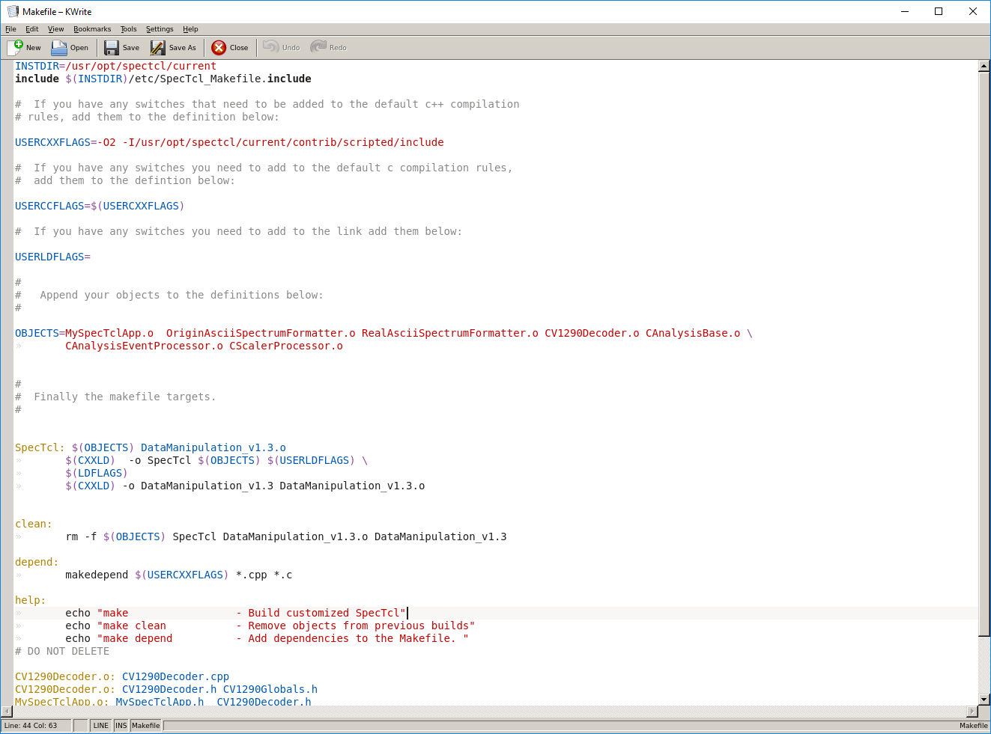
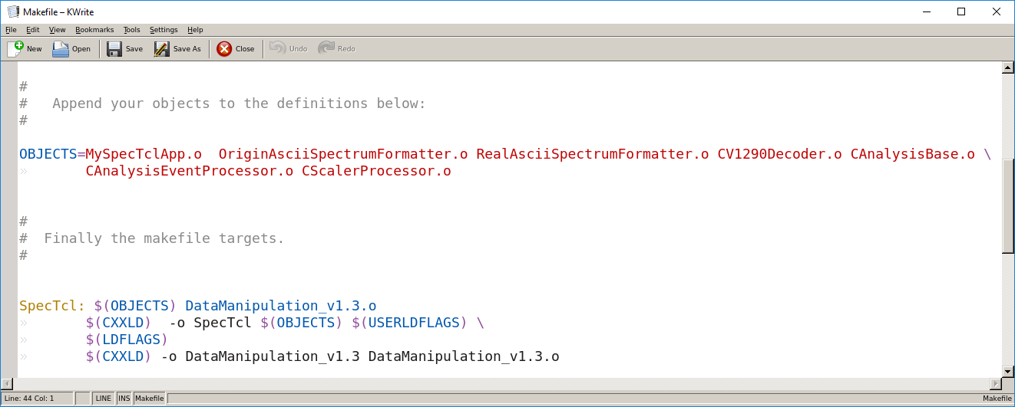
Makefile, contains all *.cpp files to compile and link
After modification, or moving to a new directory or machine:
make clean
make

Slide 8
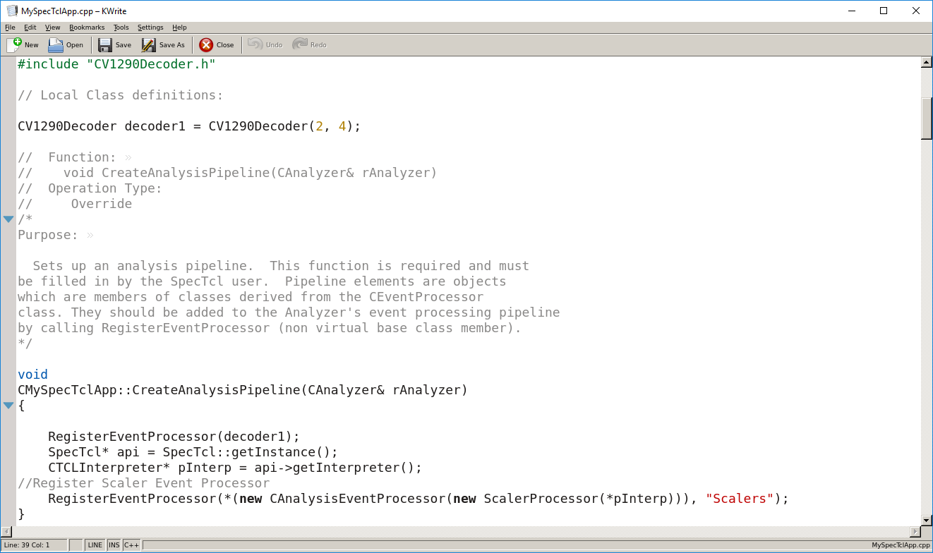
MySpecTclApp.cpp ̶ COLTRIMS
V785 Slot
V1290 Slot
Scaler processing

Slide 9
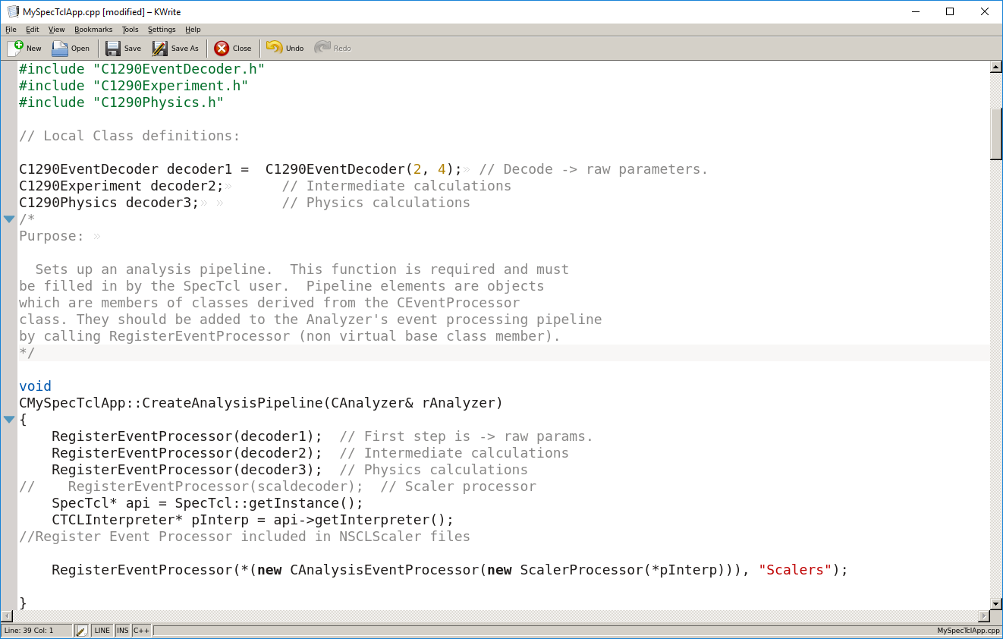
MySpecTclApp.cpp ̶ ECR
Three decoders for ECR code

Slide 10
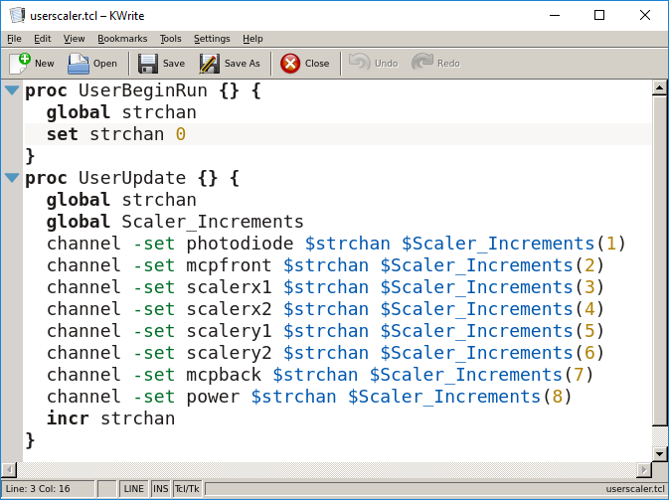
userscaler.tcl
Tcl/Tk command script updating scaler strip charts
Scaler channel name
Scaler channel number
starting at 0

Slide 11
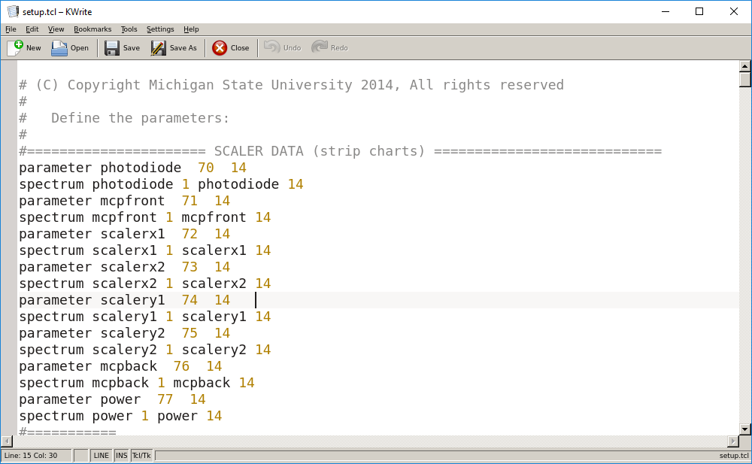
setup.tcl – defines parameters and spectra
parameter number-must be unique
parameter/spectrum size in 2^{n} channels
parameter name
spectrum name
1D spectrum

Slide 12
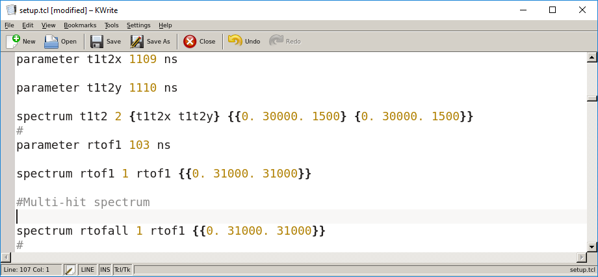
setup.tcl, continued
Max X channel
2D Spectrum
Min X channel
Number of channels
Multiple spectra can use the same parameter

Slide 13
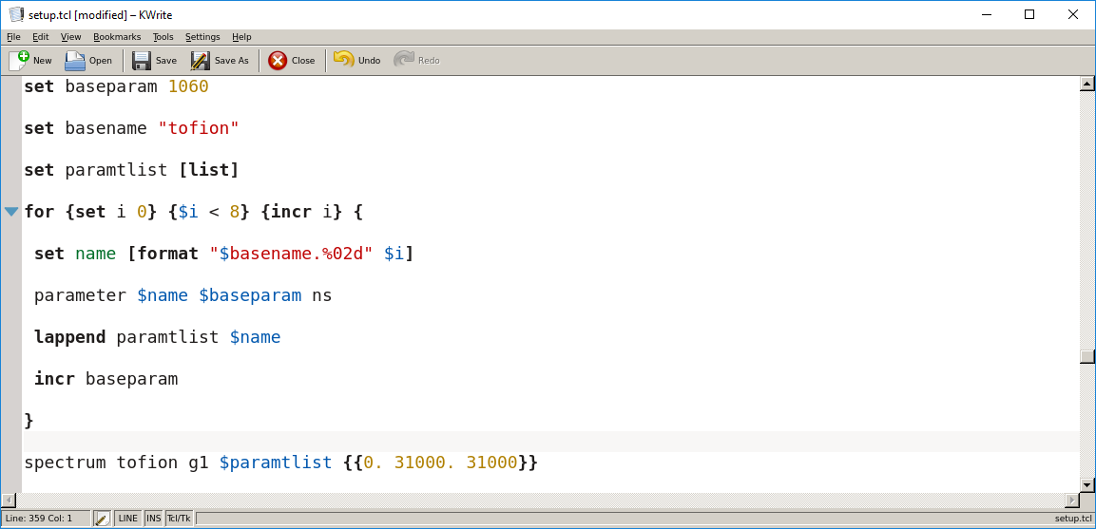
setup.tcl, continued
Define parameter for each hit, up to 8
Single 1D spectrum based on all 8 parameters in paramtlist

Slide 14
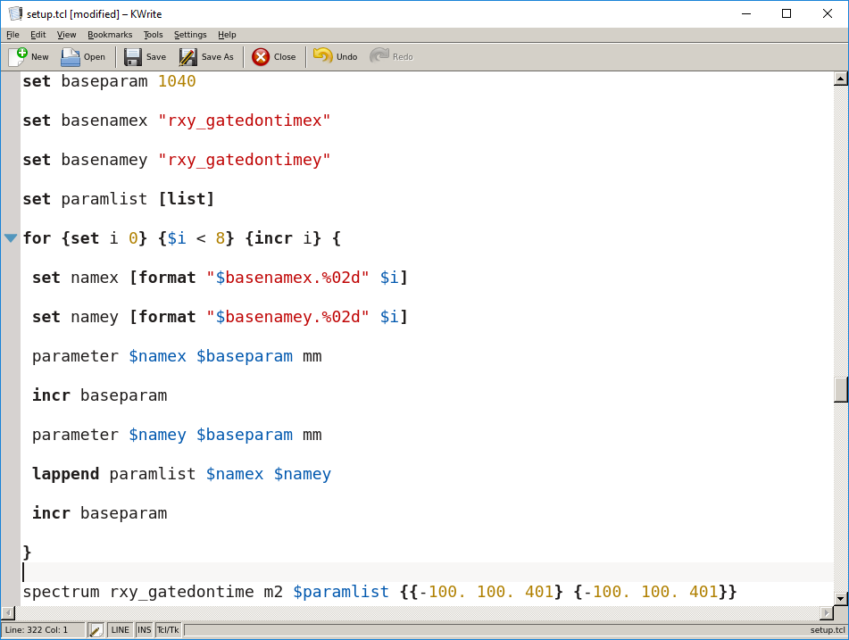
setup.tcl, continued
Define x and y parameters for each hit, up to 8
Multiply incremented 2D spectrum based on all 8
parameter pairs in paramlist

Slide 15
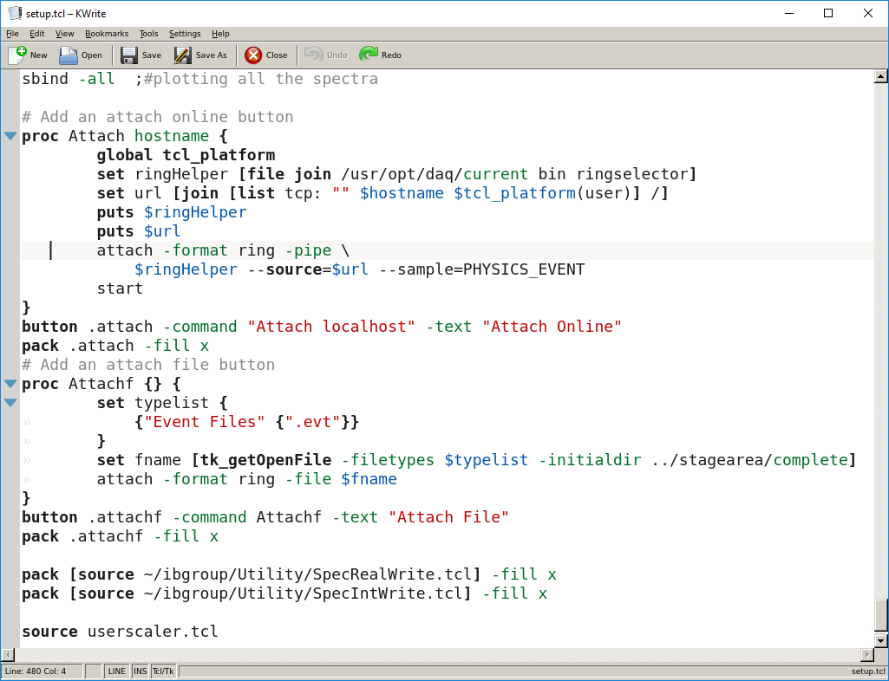
setup.tcl, continued
Let display know about all defined spectra
Define procedure
Define button
Add button to menu
Scaler update script; source is Tcl command to run

Slide 16
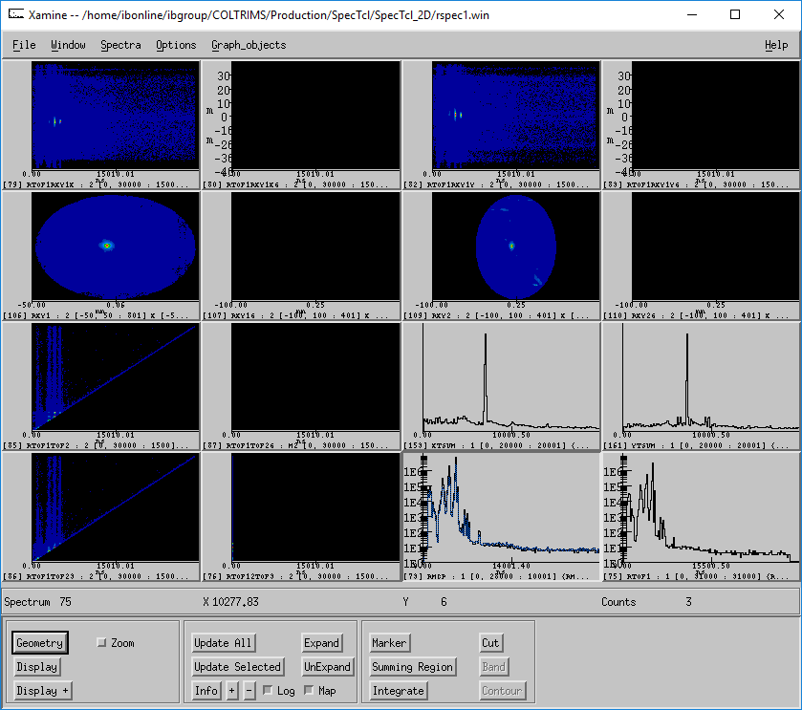
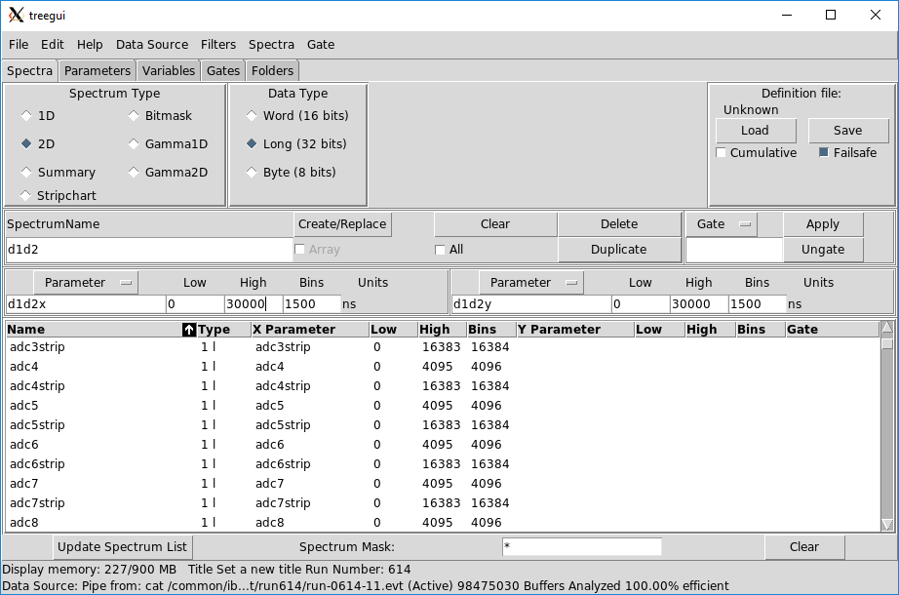
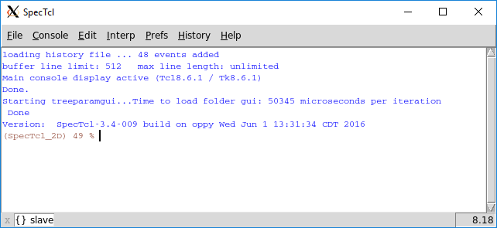
To run, type: ./SpecTcl, then in window
type: source setup.tcl
Or, type: ./SpecTcl < setup.tcl

Slide 17
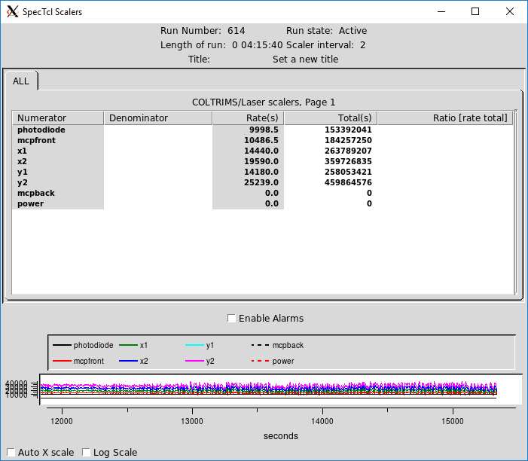
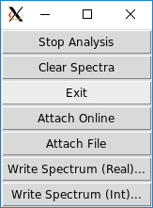
Live scaler display
Sorting control menu

Slide 18
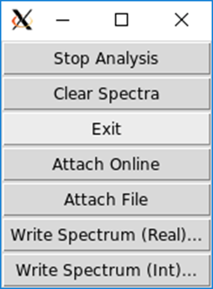
Sorting Control Menu
Start/Stop Run
Clear all spectra
Exit program
Attach Online for DAQ
Select *.evt file
Write out spectrum for
Origin plotting

