Slide 1
Readout
Online DAQ Code Tutorial
Kevin Carnes
2/12/2018

Slide 2
C1290EventSegment.cpp – V1290N TDC
Makefile – Linux file for compiling
CCAENEventSegment.cpp – V785N ADC
rdstart – Script for starting Readout
CV560Scaler.cp – V560N Scaler
Skeleton.cpp – Base file to define modules

Slide 3
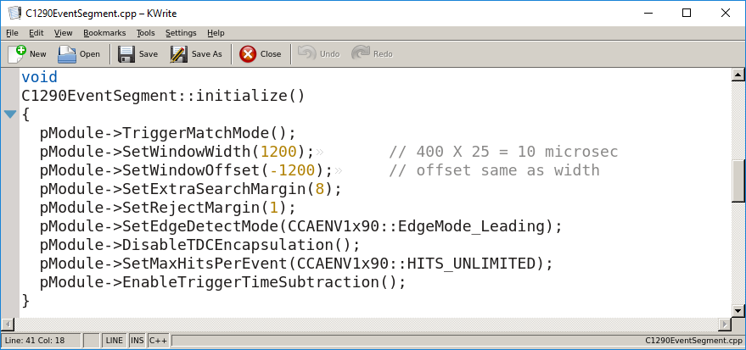

Slide 4
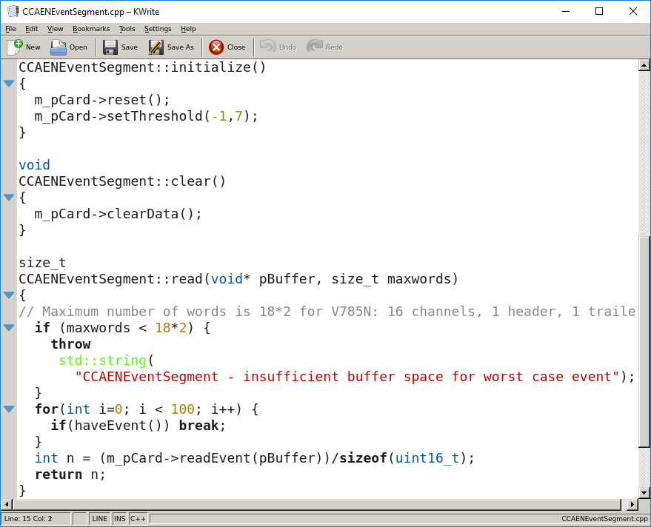
Threshold for ADC. -1 means all inputs.
7 in units of 16 channels=126.
Allow time for ADC to digitize after TDC trigger.

Slide 5
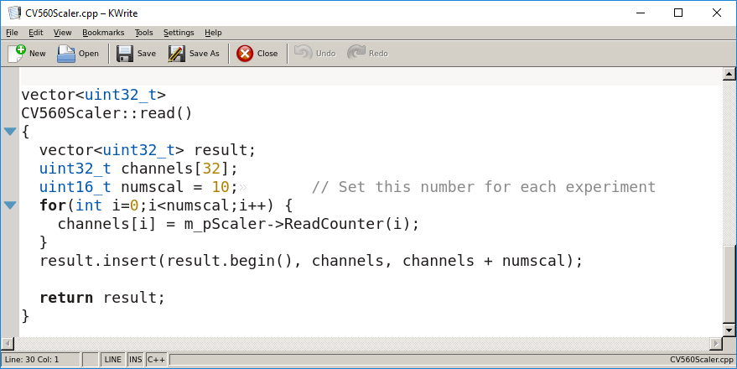

Slide 6
Names of *.cpp files included in Readout code.

Slide 7
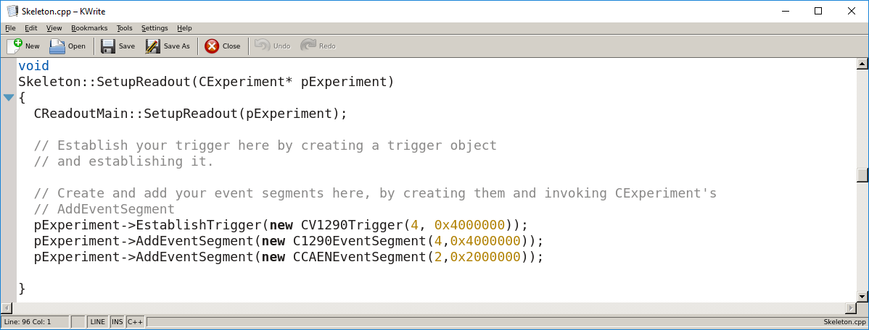
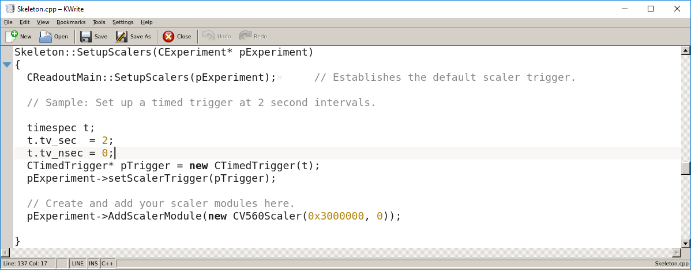
Trigger
TDC
ADC
Seconds between scaler reads.

Slide 8
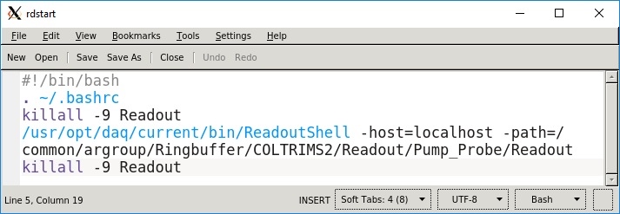
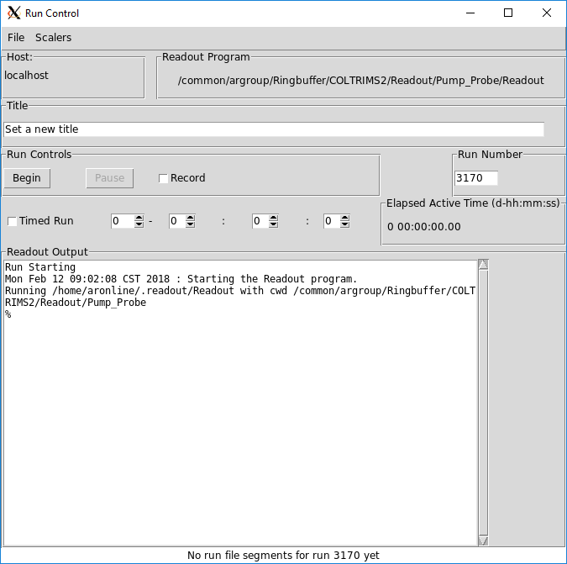
aronline@ampere:~/argroup/Ringbuffer/COLTRIMS2/Readout$ ./rdstart

